Slide 1
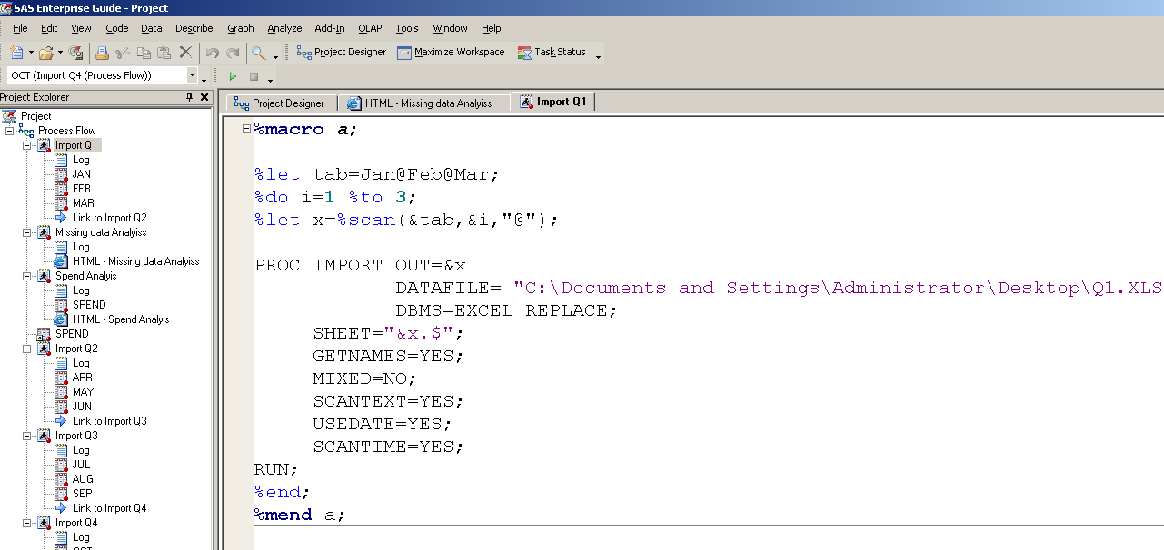
STEP 1 Importing Excel Files
The first step in the Analysis is to import the data from Excel files to SAS datasets. Proc Import one of the procedures in SAS is used to Import the data. The below mentioned code is used to Import the Excel files into SAS. This code is a macro that read the Excel file sequentially to the SAS system and do the analysis.

Slide 2
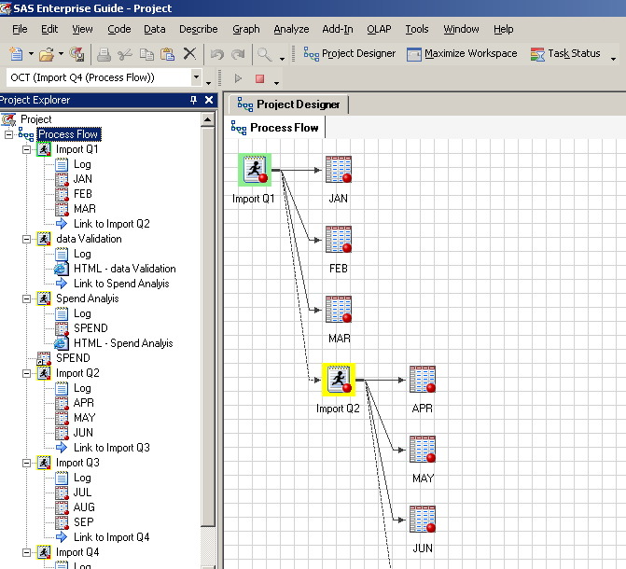
Import Q1
Import Q2
Import Q3
Import Q4

Slide 3
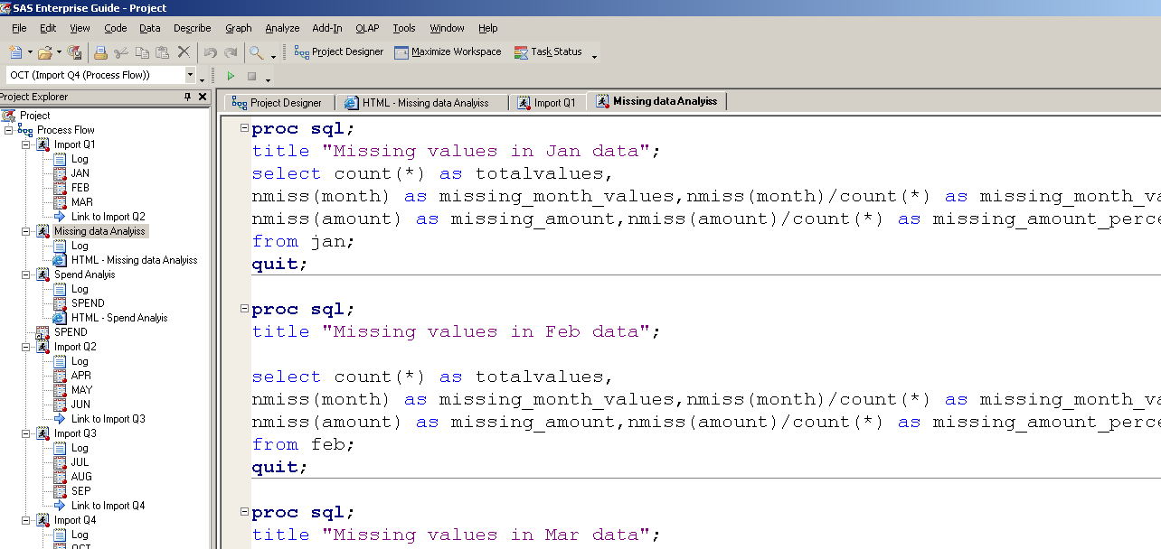
Step2 Missing data Analysis
After the Import is done using the Proc Import and Macro in SAS. The next logical step is to do the data analysis for all the months. The first thing to look in data analysis is the presence of missing values. The missing values in data cause a lot of problems and can make the Analysis incorrect. So first we try to identify the count of missing values in all the datasets and their percentages.

Slide 4
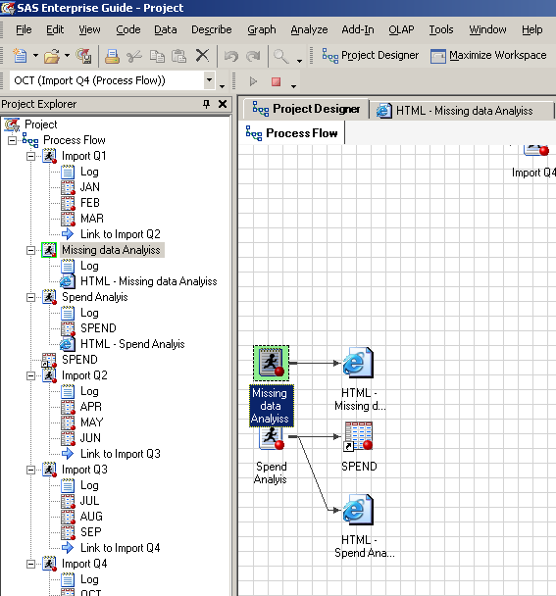
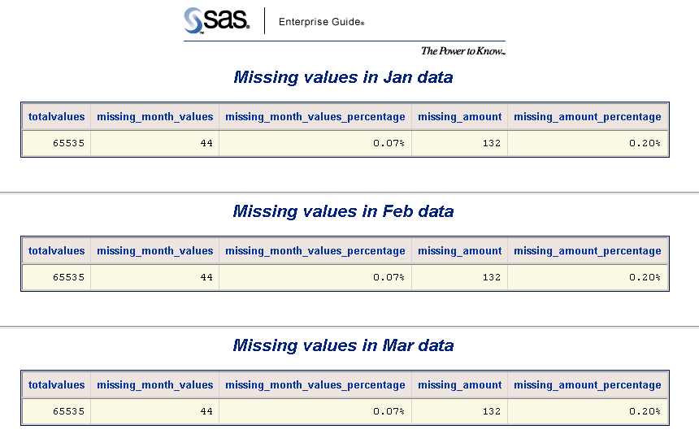

Slide 5
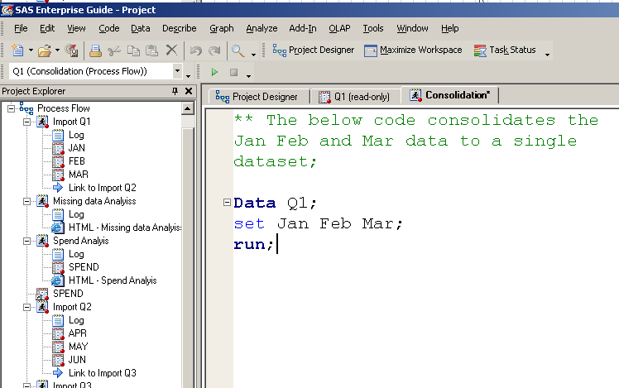
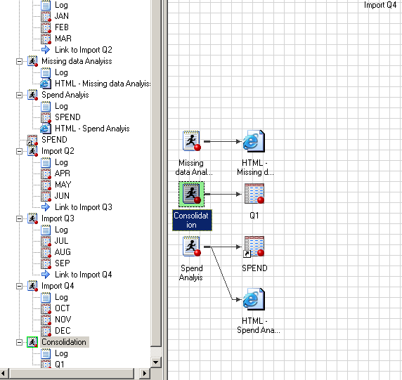
Step3 Consolidating data
After the Initial Analysis is done we would try to consolidate the data of Jan, Feb and Mar to a single dataset Q1. This would be the master dataset for doing the analysis and understanding the customer behaviour.

Slide 6
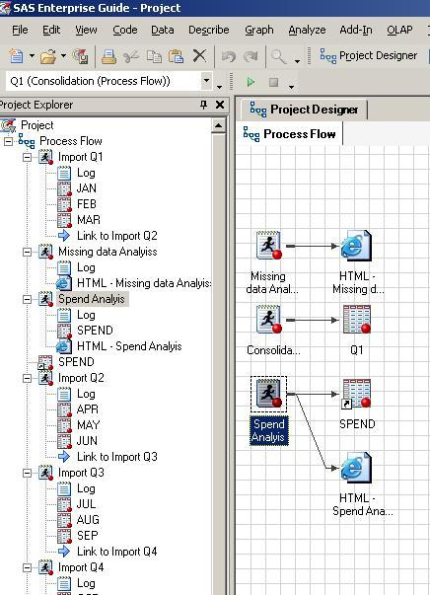
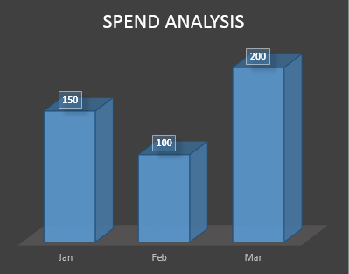
Step4 Spend Analysis of All the months of Quarter1
After the consolidation is done for the Quarter1 of the year we try to find the Analysis of spend pattern on various categories for the individual months of Quarter1.
Spend pattern for Q1 in Lakhs.

Slide 7
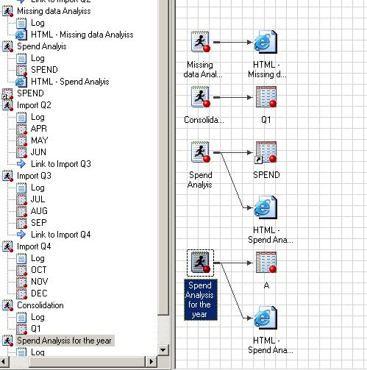
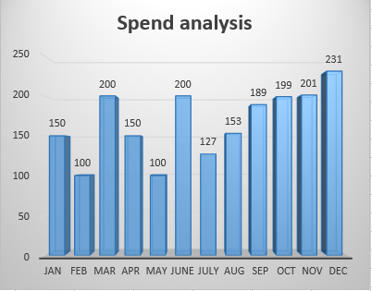
Step5 Spend Analysis of All the months of the year
After the consolidation is done for the year for all months, we try to understand the spending pattern for all months of the year.
Spend pattern for the year Lakhs.

Slide 8
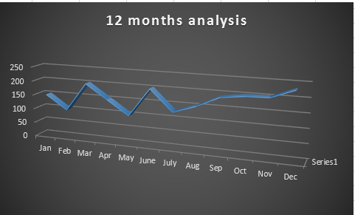
Step6 Spend Analysis of All the months of the year
After the consolidation is done for the year for all months, we try to understand the spending pattern for all months of the year. The line graph helps in understanding that the spend is increasing in decreasing in various months of the year.
Spend pattern for the year in Lakhs.

Slide 9
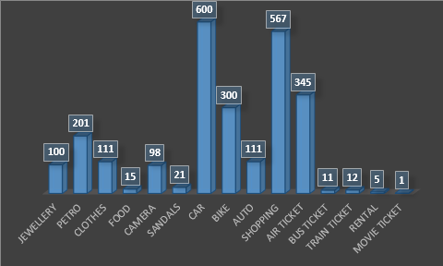
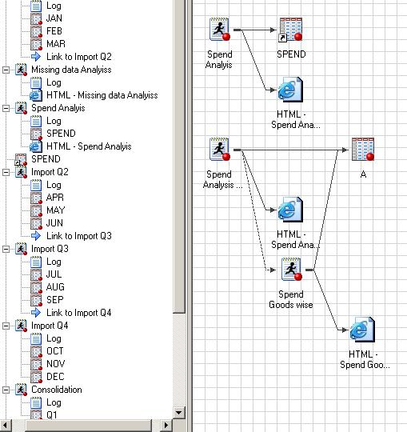
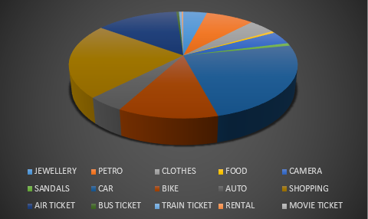
Step7 Analysis of the spend Goods and services wise
After the consolidation is done for the year for all months, we try to understand the spending pattern for all months of the year and goods and services wise. This helps in understanding how the customers are spending in all the goods and services.
Spend pattern Goods and services wise

Slide 10
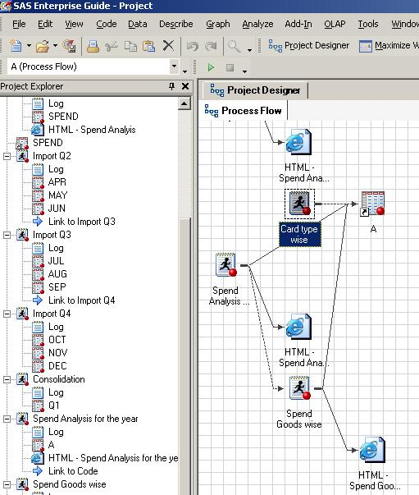
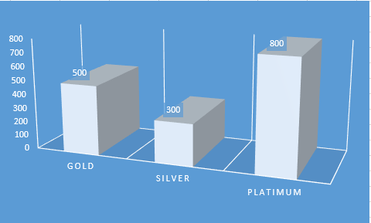
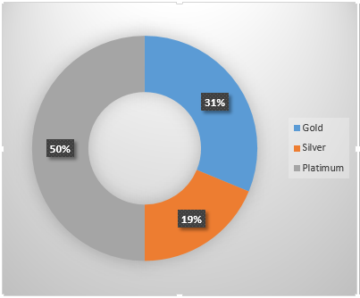
Step8 Analysis card type wise After the consolidation is done for the year for all months, we try to understand the spending pattern for types of credit cards issues by the bank.
Spend pattern Card type wise

Slide 11
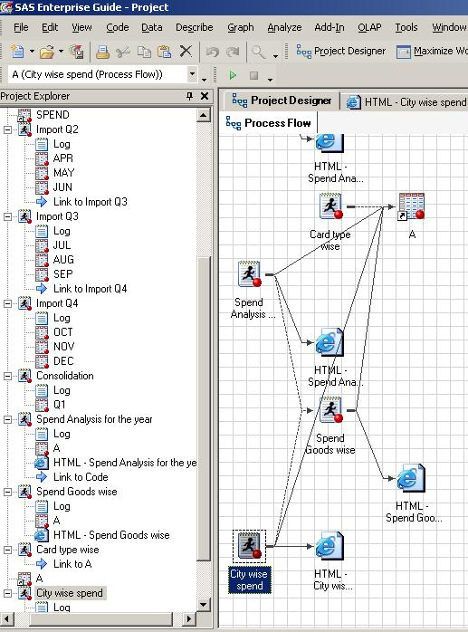
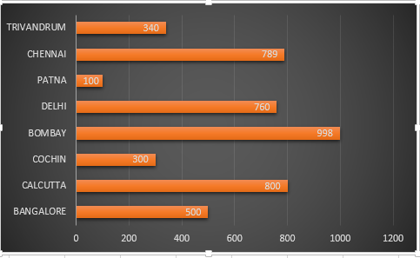
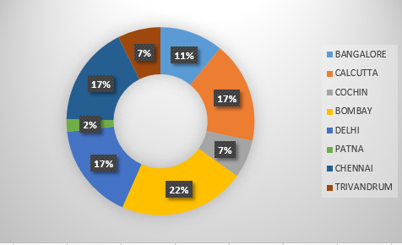
Step9 Analysis of the spending pattern city wise, this helps the bank to decide the budget city wise for promotion activities.
Spend pattern city wise

